Slide 1
Green Horizons
2025 REQUEST FOR APPLICATIONS
To hear the narration,
go to “Slide Show” and click “Play from Start”

Slide 2
GREEN HORIZONS PROJECT
SEF is proud to partner with the Native American Agriculture Fund (NAAF) to administer the Green Horizons Project, a funding opportunity for Tribal governments that provides capital and capacity building to promote environmental sustainability in Native agricultural and food systems.
The mission of the Green Horizons Project is to accelerate existing efforts that provide support for Tribal agricultural producers implementing sustainable practices on their farm(s) and/or ranch(es).

Slide 3
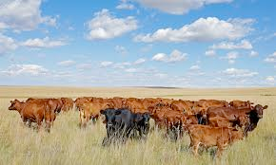
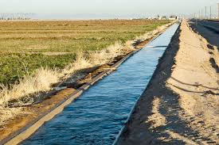
OVERVIEW
Eligibility:
Topic:
Budget:
Tribal governments
Sustainable ag
$40,000
State and federally recognized Tribal governments are eligible to apply. Tribes may choose to partner with other entities, but the Tribe must be the lead applicant (e.g., be key personnel, manage the budget and report to SEF).
This opportunity is designed to assist Tribes in helping Tribal producers implement sustainable ag practices. It is best suited for Tribes who want to build on an existing program.
Funds can be used for personnel, direct expenses (i.e., supplies, equipment, travel, events, stipends, consultants), and indirect costs up to 15%. All budgets must total to $40,000 exact.

Slide 4
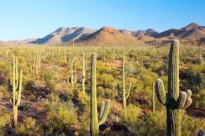
SUSTAINABLE AG PRACTICES
Soil Health:
Water Use:
Climate Change:
Our Land
Our Water
Our Air
Examples include:
Cover crops
Reduced tillage
Rotational grazing
Compost
Etc.
Examples include:
Drip irrigation
Smart sensors
Solar wells
Rainwater catchment
Etc.
Examples include:
Reduced fossil fuel use
Increased renewables
Agroforestry
Biochar
Etc.

Slide 5
TIMELINE
Opens
Closes
Decisions
Start
End
March 1st
June 15th
August
October 1st
September 30, 2026
APPLICATION COMPONENTS
Eligibility information
Geographic information
Proposal: narrative, plan, budget, key personnel
Governing body information
Cover letter

Slide 6
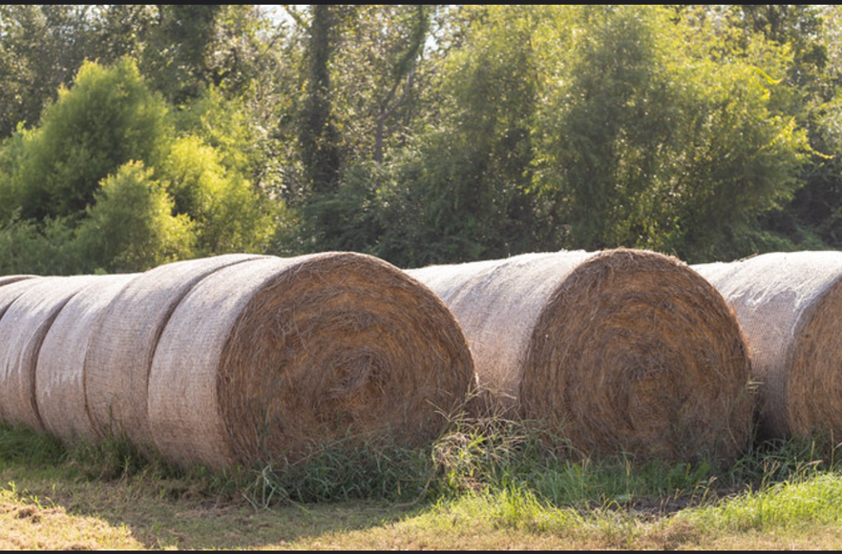
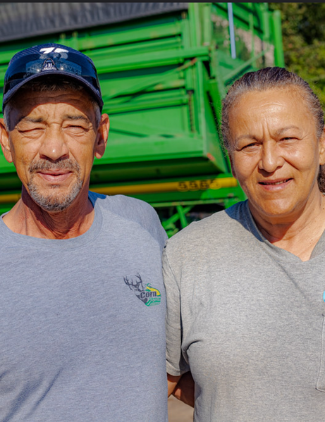
EVALUATION CRITERIA
Vision
Contribution
10 points
20 points
Plan
Team
20 points
20 points
Budget
Sustainability
20 points
5 points
Evaluation
Total
10 points
100 points

Slide 7
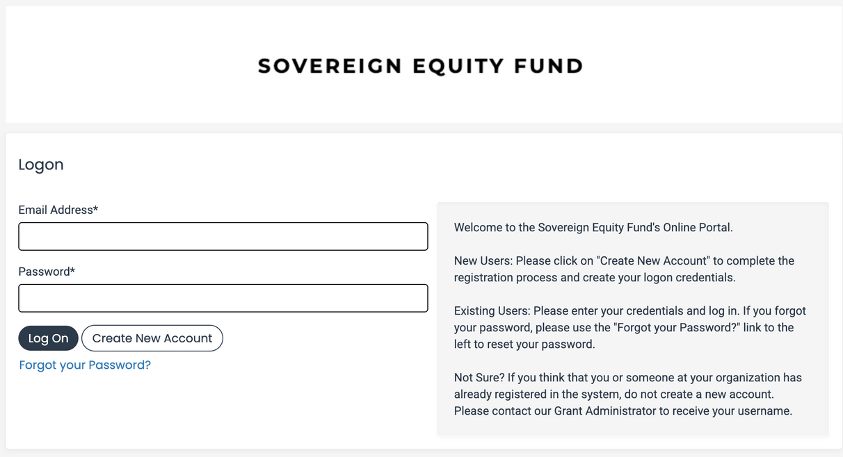
HOW TO APPLY
All applications are submitted through SEF’s online grant management system, Foundant. Applicants can make a profile, start the application, and save to come back later. Refer to our Foundant Tutorial or reach out if you have any questions about the system.
DEADLINE
Applications are due on Sunday, June 15 at 11:59 pm Alaska Time. No extensions. Please apply early and reach out if you have issues.

Slide 8
SUPPORTING FILES
RFA Overview
Budget Guidelines
Frequently Asked Questions
Foundant Tutorial
Budget Template (required)
Sample Budget
Sample Budget Narrative
Link to Foundant
VISIT OUR
WEBSITE:
www.sovereignequityfund.org/home/greenhorizons

Slide 9
Thank you for your time and interest.
Contact:
grants@sovereignequityfund.org

